Slide 1
FPGA Development
in the Norwegian Industry
Espen Tallaksen
www.bitvis.no

Slide 2
Bitvis AS
Independent Design Centre for Embedded SW and FPGA (& ASIC)
Founded January 1, 2012
  6 designers – from March 1, 2012
  Expect to increase significantly in 2012/13 (9 designers from Oct.)
Major focus on Efficiency & Quality Improvement
  Through a structured Methodology
  Real improvements, - Not just empty words in a company policy…
Customer partnership
  Focus on Customer hand-over (avoiding "legacy consultants")
  Also improve customers' methodology (when wanted)
Methodology, Reviews, Sparring partner
www.bitvis.no
FPGA Development in the Norwegian Industry

Slide 3

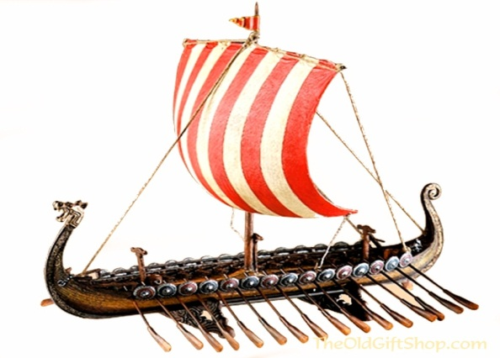



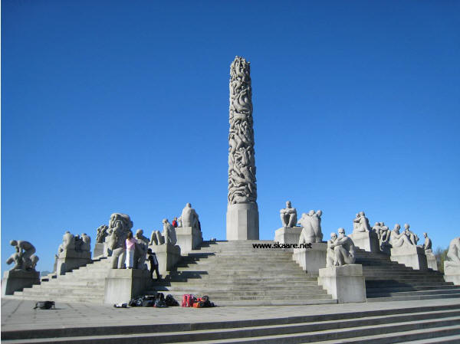
Norwegian Electronics Industry
Have you ever heard of it?
FPGA Development in the Norwegian Industry

Slide 4
Norwegian ASIC/IC Industry
Chipcon (now TI)
  Advanced RF and ZigBee IC solutions (TI 2005, $200M)
Oracle
  World's fastest switches (Infiniband) (for Hi perform. Comp.)
Falanx (now ARM)
  Advanced GPUs (ARM 2006, $30M)
Atmel
  Extremely successful with the AVR (8/32-bit uCtr (Risc))
Nordic Semiconductor
  Ultra low power RF ICs/solutions
Energy Micro
  'The world's most energy friendly microcontrollers and radios'
FPGA Development in the Norwegian Industry

Slide 5
Norwegian FPGA projects
Major diversity
Succeeding dispite the high level of cost
Tomra
SquareHead
Technology
Radionor
Kongsberg Defence
and Aerospace
Hittite
GE Healthcare
Eidsvold
Electronics
Thales
WesternGeco
TSat
Kongsberg
Spacetec
Aurotech
Electronics
Ceragon Networks
HDD
Cisco
AV Satcom
T-Vips
Vinghøg
Polewall
AppearTV
3D Perception
Kongsberg
Seatex
ABB
FMC
ProjectionDesign
FPGA Development in the Norwegian Industry

Slide 6

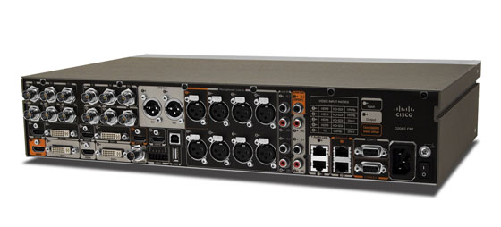

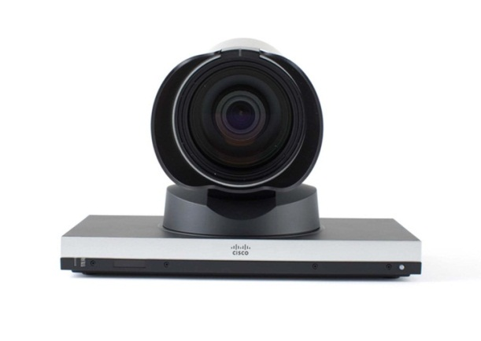
Cisco
Cisco TelePresence System Codec C90
- 6 FPGA’s
- Video composing/scaling and menu overlay of
up to 9 full HD (1080p60) outputs
- 15 Gbit/s video backplane over LVDS between FPGA's
- Nios II soft processor
- 280k VHDL code lines (including testbench code)
Originally "Tandberg"
Acquired by Cisco in 2010 ($3,3B)
Cisco PrecisionHD 1080p60 12x Camera
- Complete image processing pipeline in FPGA
- Test-Driven Development (TDD) using custom MATLAB
and HDL framework
- Current high-end video conferencing camera
- Image processing pipeline re-used in various Cisco
TelePresence Endpoints
- 210k VHDL codelines (including testbench code)
FPGA Development in the Norwegian Industry

Slide 7


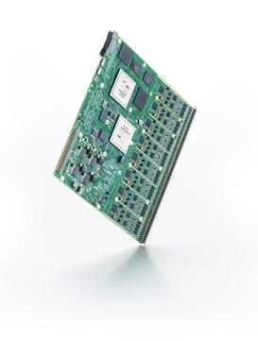
MANUS – Miniaturized Application-Neutral Ultrasound System
OEM high-end ultrasound engine for medical use.
Easily and intuitively adapted to customer application.
Configurable FPGA signal processing is a key to easy meet OEM customer needs.
Fully parallelized custom signal processing to give high speed of signal processing at low clock rates.
Example of function implemented in FPGA:
  RX Beamformer 144 GMAC/s @ 125 MHz.
  Input data bandwidth 192 Gbit/s.

Slide 8

Kongsberg Defence & Aerospace
Antifuse to Mercury - BepiColombo mission
15 Feb2012 – Jostein Ekre
Senior System Engineer - Space
WORLD CLASS – through people, technology and dedication

Slide 9

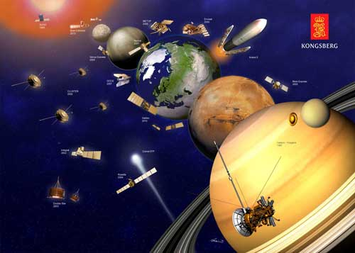
BepiColombo mission 2014-2022 to Mercury
Journey: Two orbiters installed on one carrier (MTM) will be launched on a single Ariane 5 rocket from ESA's Spaceport in Kourou, French Guiana in 2014 to Mercury.
Transfer module, Mercury Transfer Module (MTM: 2014-2020)
  Kongsberg Defence & Aerospace is responsible for development and deliverance of SADA( Solar Array Deployment Assembly). KONGSBERG is currently Norway's largest supplier to ESA, the European Space Agency:
  Earth observation satellites (Aeolus, ENVISAT, GOCE og METOP)
  Scientific space probes (Cassini-Huygens, Cluster, Darwin, Double Star, Integral, Mars Express, Planck, Rosetta, Soho og Venus Express) -→ BepiColombo
  Navigation satellites (Galileo)
  Booster rockets (Ariane 5 DAAV/DAAR, OptoPyro og Vinci)
SADA: SADM + SADE
  SADM: Solar array deployment mechanism
  SADE: Solar Array deployment electronics
FPGA related functions in SADA (SADE/SADM):
  Commanding the SADM movements through the entire mission from launch to target
  Control loop Feedback performances
  Motor torque, current
  Accuracy of the angular positioning system
  SADM temperature measurement and accuracy
  Acceleration and deceleration algorithms
  Angular Position
  Housekeeping
  Timing diagrams of movements and commanded profiles
/ <number> /

Slide 10
Norwegian FPGA environment
Norwegian distribution market is approx the same size as the Swedish distribution market
A very high relative value of the electronics industry
  The utilisation of FPGA technology in the Norwegian electronics industry is very high.
Lots of really complex FPGAs
  Pushing the limits on performance
Also lots medium complexity FPGAs
FPGA development tend to be time consuming and error prone
→ Must assure the right quality
→ Must constantly improve efficiency
FPGA Development in the Norwegian Industry

Slide 11
Main quality/efficiency problems
Applies
world-
wide
Most “self inflicted” quality and efficiency problems have the same few root causes.
  Design complexity
    with lack of structure
  Verification
    with unstructured TB or lack of simulation
  Timing and clocking
    Timing Closure
    Internal CDC
    External I/O timing req. + CDC
So – what does the FPGA world do about this?
FPGA Development in the Norwegian Industry

Slide 12
Imbalanced focus on improvement activities
Tool vendors focus on the most advanced needs
Academia focus on the most advanced needs
An advanced focus is required,
but…..
Insufficient focus on the needs of the majority of the industry
  Need help – at the right level
(Using verification to exemplify…)
Level of methodology and structure applied in the development in various companies
FPGA Development in the Norwegian Industry

Slide 13
Verification
– NOT the state of the art
Most companies do not simulate sufficiently
Most companies have a terrible TB structure
Most designers have insufficient knowledge about verification and testbenches
Most companies have insufficient awareness on the importance of proper and structured verification
FPGA Development in the Norwegian Industry

Slide 14
Verification – what do we need?
Important to focus on the most advanced needs
  For those few who really need it today
  For the FPGA community – for the future
➔ Major improvement potential (Quality + Eff.)
The large majority have totally different needs
  Awareness → knowledge → experience → structure
  Structure: Flow, Documentation, Architecture, Coding
  Self-checking, Coverage, Transcripts, Debugging
  Step – by – step……
A huge potential for improvements
  For a large majority…
  20-50%
Verification
maturity in companies developing
FPGAs
BUT:
$$$
FPGA Development in the Norwegian Industry

Slide 15
How can we improve verification
– for this large majority
Academia in the education
  More on practical approach and structure
  More on quality in the development flow
Academia – research – for the future
  Slightly more focus on industry friendly approaches
Tool vendors
  Address the industry at the right level
  A company with an insufficient verification methodology first needs help improving awareness, knowledge and structure
    THEN they may mature -
    and later become a good customer for advanced solutions….
FPGA Development in the Norwegian Industry

Slide 16
FPGA Development Best Practices
Why does this have so little attention
  There are courses on technology, languages, frameworks, etc…
  But apparently none on FPGA development in general
Could this be the responsibility of a university…. ?
Bitvis: 2-day course on "FPGA Development Best Practices"
  A pragmatic and structured approach to handle the main quality and efficiency challenges
  Focus on the worst time wasters, the most common quality problems and the most important improvement potentials
  Design structure, Verification structure and CDC
  Awareness → Knowledge → Practical approach
  Step – by – step
  Very good feedback after various courses in Scandinavia
FPGA Development in the Norwegian Industry

Slide 17
Sharing Knowledge and Experience
2004
  EMBLA: A Norwegian inter-company cooperation
    Intention: High level system development (ASIC + SW)
    Byproduct: "Platform based development"
  DAK-forum: A 20-year old seminar
    Mainly ASIC / Embedded, but also RF, Analog, PCB, FPGA
    Exhibition - mainly with the main ASIC tool vendors
    Number of participants steadily declining
      Too academic
      Too broad
      Insufficient support from the industry
    A very good concept for networking
    DAK-forum coordinator very open too new ideas
2005 - A joint seminar for DAK-forum & FPGA-forum
FPGA Development in the Norwegian Industry

Slide 18
FPGA-forum focus
Main target is the Norwegian Industry
  Less academic & less potential future tools/lang/etc.
  Narrow focus. FPGA related only
  Something of interest throughout the seminar
  More presentations relevant to developers' daily work
  Minimise direct marketing from the vendors
50% of presentations are from the Norwegian industry
  On projects, tools, methodology and experience
Networking
  Dinner party gathers >95% of the participants
    Important to have the event outside Oslo
  Lots of senior developers and decision makers
FPGA Development in the Norwegian Industry

Slide 19
FPGA-forum today
Two full days (www.fpga-forum.no)
  Two separate tracks
  International keynotes (2013: Dennis Segers, CEO Tabula Inc)
  (Previous: Clive Maxfield, Wayne Luk, Patrick Lysaght, Hartenstein, Becker)
120-130 participants
  Industry 80, Vendors 20, Academia 10, Students 20
A paid event (€ 550-800)
  Lunch, coffee and dinner included (no option)
Exhibition and Recruitment stand
  All the major Vendors are present
  Vendors very pleased with "the quality of the participants"
High quality presentations
  Very good feedback from the partcipants
Helps the Norwegian FPGA community improving
Next FPGA-forum:
Wedn+Thur, February 13-14, 2013 (in Trondheim)
FPGA Development in the Norwegian Industry

Slide 20
Summary
There is an electronics industry in Norway
  Part of the FPGA industry is really advanced
  The cost of living is not a show stopper
  Engineers and specialists are relatively cheap
Imbalanced focus from vendors and academia – world-wide
  Need more Awareness, Knowledge, Structure & Reuse
  Best Practices and good structuring may reduce workload by 20-50% - with improved quality as a bonus
FPGA-forum contributes to a better FPGA community
  Focusing on the needs of the industry is critical
  There are of course lots of improvement potentials…
FPGA Development in the Norwegian Industry

Slide 21
Bitvis
Thank you
www.bitvis.no
FPGA Development in the Norwegian Industry

